Slide 1


10:57 am
Smart Assistant
Look into Camera for Facial Recognition login
Enter Password
Start

Slide 2




10:57 am
Smart Assistant
Medication
Energy Usage
Exercise
Cozmo
Help
Settings

Slide 3
10:57 am
Smart Assistant
Contact Information
Phone number: 01315568234
Email: helpdesk@smartassistant.co.uk
If you are having any issues please contact us via the above methods.
Medication
Energy Usage
Exercise
Cozmo
Help
Settings

Slide 4
10:57 am
Smart Assistant
Contact Information
Phone number: 01315568234
Email: helpdesk@smartassistant.co.uk
If you are having any issues please contact us via the above methods.
Medication
Energy Usage
Exercise
Cozmo
Help
Settings

Slide 5
10:57 am
Smart Assistant
Medication
Energy Usage
Exercise
Cozmo
Help
Settings

Slide 6








Exercises
10:57 am
Tai Chi
Hand Grasping
Seated Rowing
Seated Cycling
5 minutes
9 minutes
6 minutes
22 minutes
Edit
Notes:
Press Exercise button to do that exercise.
Press + button to add new exercises to list.
Press back button to go back to main page.

Slide 7
Exercises
10:57 am
Tai Chi
Bowling
Seated Rowing
Seated Cycling
5 minutes
9 minutes
6 minutes
22 minutes
Edit
Notes:
Press Exercise button to do that exercise.
Press + button to add new exercises to list.
Press back button to go back to main page.

Slide 8









Add Exercises
10:57 am
Tai Chi
Golf Exercise
Bowling
Exercise Title
5 minutes
9 minutes
15 minutes
9 minutes
Tai Chi ,be mindful of your body’s movements as well as your breathing and the sensations that your body is experiencing. Try to move like water
Improve your swing
Improve your form in bowling.
Description
Add
Remove
Add
Remove
Add
Remove
Add
Remove
Notes:
Press tick box to add to personal exercise list.
Press exercise button do a run though of the exercise to see if suitable.
Back button takes you back to exercise page.

Slide 9
Add Exercises
10:57 am
Tai Chi
Golf Exercise
Bowling
Exercise Title
5 minutes
9 minutes
15 minutes
9 minutes
Tai Chi ,be mindful of your body’s movements as well as your breathing and the sensations that your body is experiencing. Try to move like water
Improve your swing
Improve your form in bowling.
Description
Add
Remove
Add
Remove
Add
Remove
Remove
Add
Remove
Add
Notes:
Press tick box to add to personal exercise list.
Press exercise button do a run though of the exercise to see if suitable.
Back button takes you back to exercise page.

Slide 10
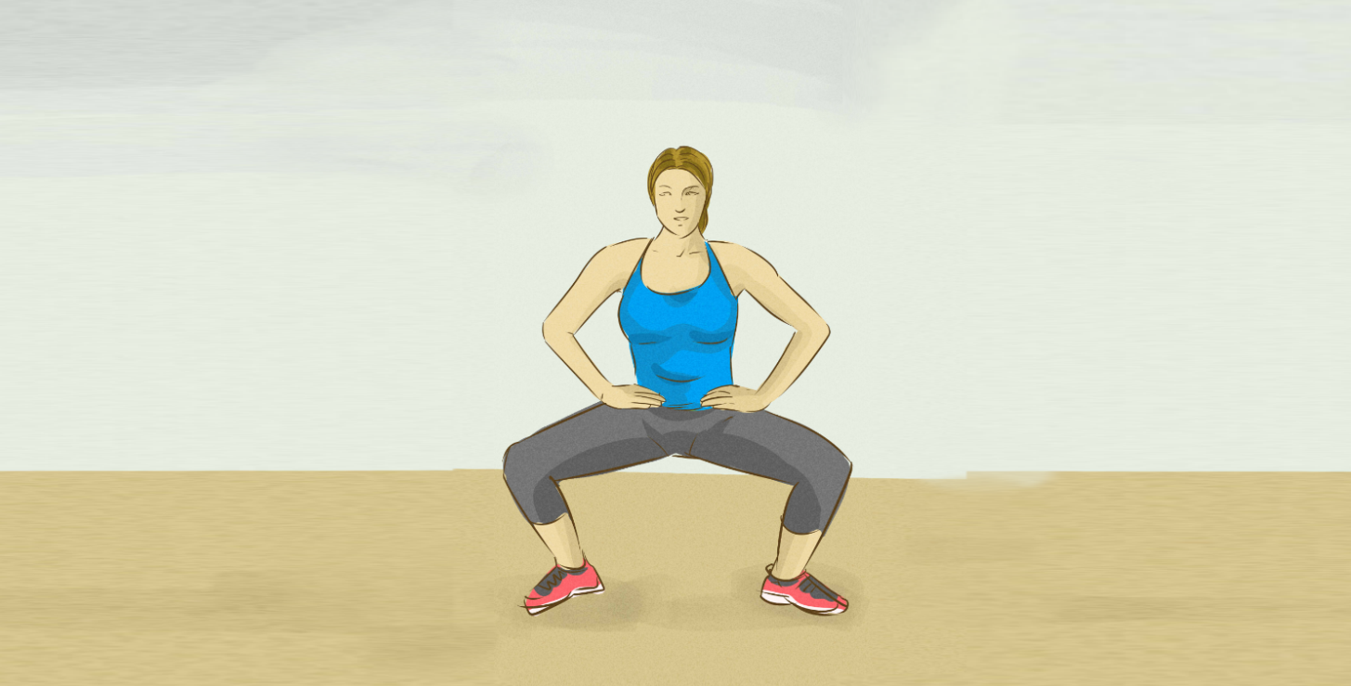
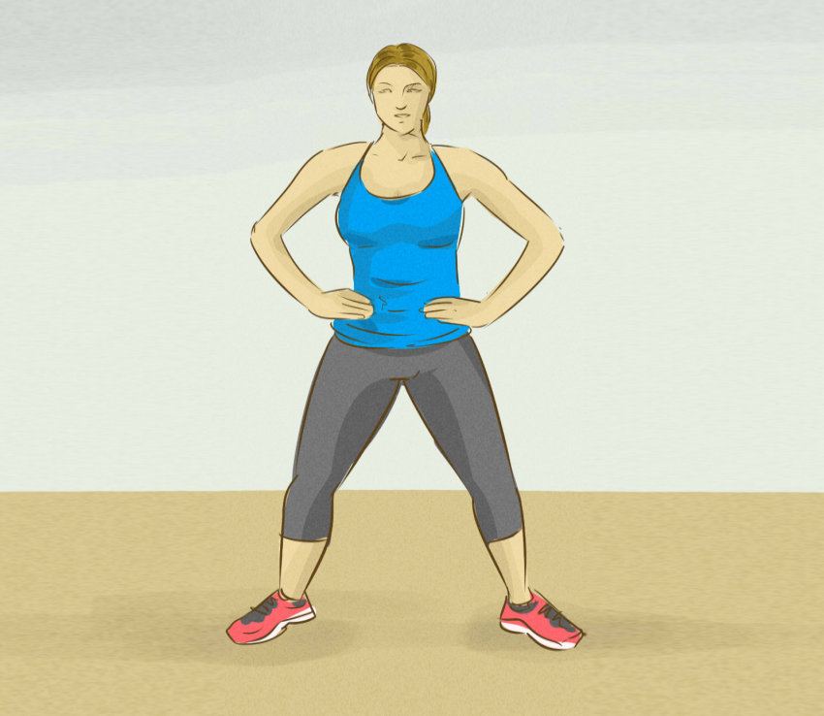

Tai Chi
10:57 am
Good Job!
Notes:
Has animation showing the exercise with voice over.
Can pause at any time by pressing the || button.
Can stop exercise by pressing back button.

Slide 11

Tai Chi
10:57 am
10
Good Job!
Notes:
Can have countdown. For example when a position should be held for a period of time.

Slide 12
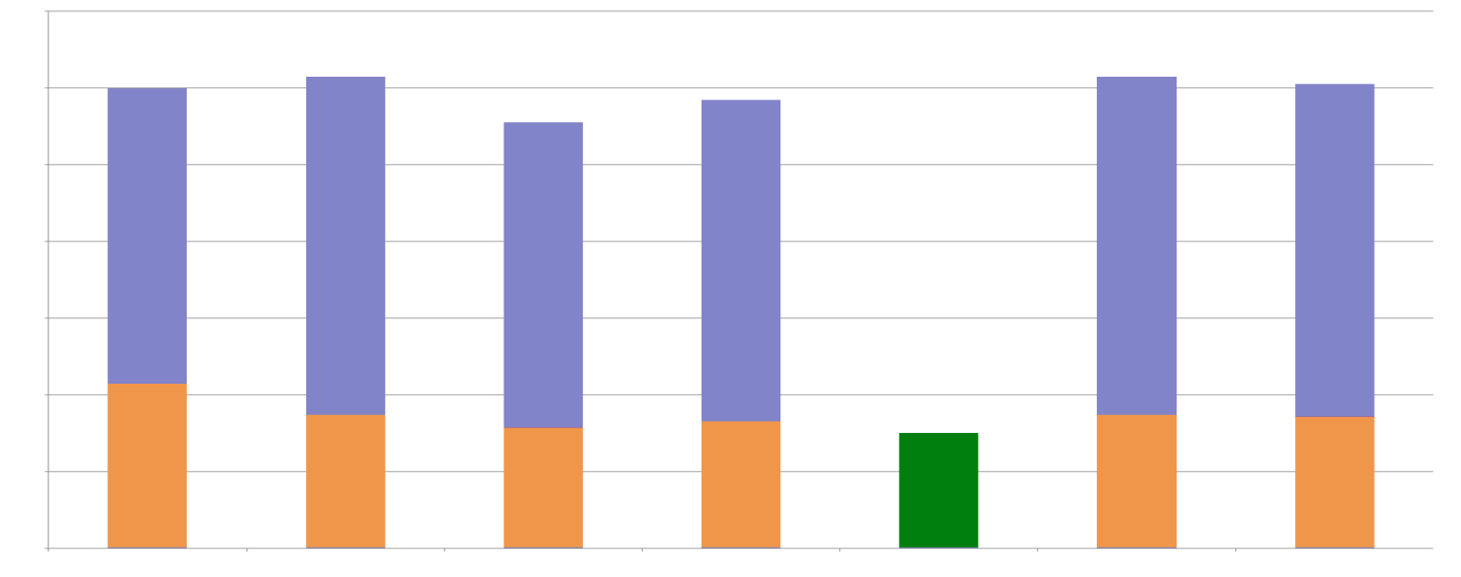

Energy
10:57 am
Total daily energy usage
Energy Usage (kwh)
Equivalent energy usage
Monday
Tuesday
Wednesday
Thursday
Friday
(Today)
Saturday
Sunday
Tip:
The Kitchen light has been left on for 6 hours.
Edit
Notes:
Shows basic layout of house with information on what lights/appliances are on.
Press + button to add/modify room/appliance.
Back take user to main menu

Slide 13
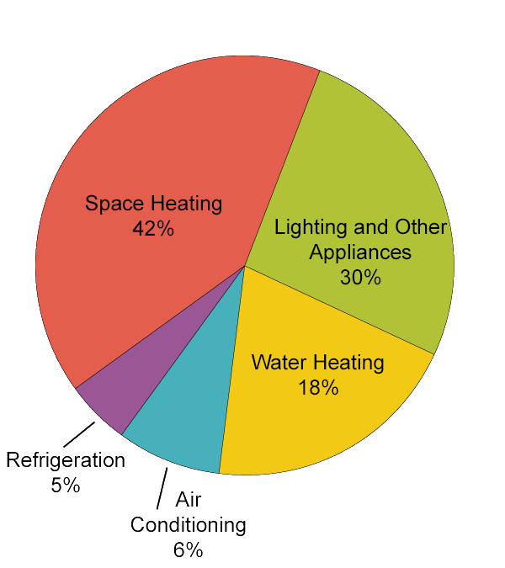
Friday
10:57 am
Breakdown of energy usage:

Slide 14
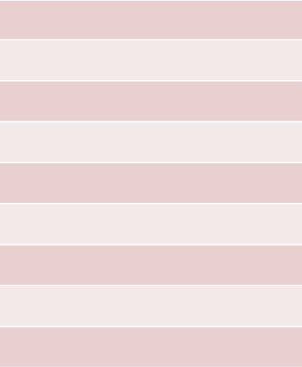
Energy
10:57 am
Smart Appliances Detected
Appliances in House
IOT Bosch Water Heater
Smart Oven
Smart Ikea Light 10
Refresh
Tip:
If you can’t see the device you are looking for in the list press the refresh button.

Slide 15
Energy
10:57 am
Smart Appliances Detected
Appliances in House
Smart Oven
Smart Ikea Light 10
IOT Bosch Water Heater
Refresh
Tip:
If you can’t see the device you are looking for in the list press the refresh button.

Slide 16
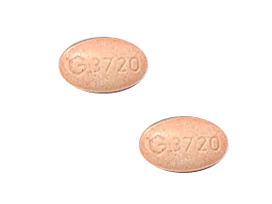
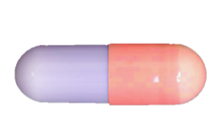
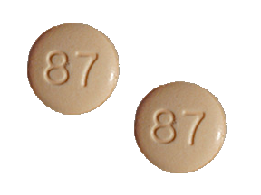






Medication – Friday (Today)
10:57 am
Change day
Formohelidrine
Oxytocin
Tetracoloridine
8:00 am
11:00 am
6:00 pm
Edit

Slide 17
Medication – Friday (Today)
10:57 am
Change day
Formohelidrine
Oxytocin
Tetracoloridine
8:00 am
11:00 am
6:00 pm
Edit

Slide 18
Medication – Friday (Today)
10:57 am
Change day
Formohelidrine
Oxytocin
Tetracoloridine
Warning
This medication should not be taken until 6:00pm
If this medication has been taken seek medical advice.
8:00 am
11:00 am
6:00 pm
Edit

Slide 19
Medication – Friday (Today)
10:57 am
Change day
Formohelidrine
Oxytocin
Tetracoloridine
Warning
This medication should not be taken until 6:00pm
If this medication has been taken seek medical advice.
8:00 am
11:00 am
6:00 pm
Edit

Slide 20
Medication – Monday 21st
10:57 am
Change day
Formohelidrine
Oxytocin
Tetracoloridine
8:00 am
11:00 am
6:00 pm
Edit

Slide 21
Medication – Monday 21st
10:57 am
Change day
Formohelidrine
Oxytocin
Tetracoloridine
Warning
This medication should not be taken until 6:00pm
If this medication has been taken seek medical advice.
8:00 am
11:00 am
6:00 pm
Edit

Slide 22
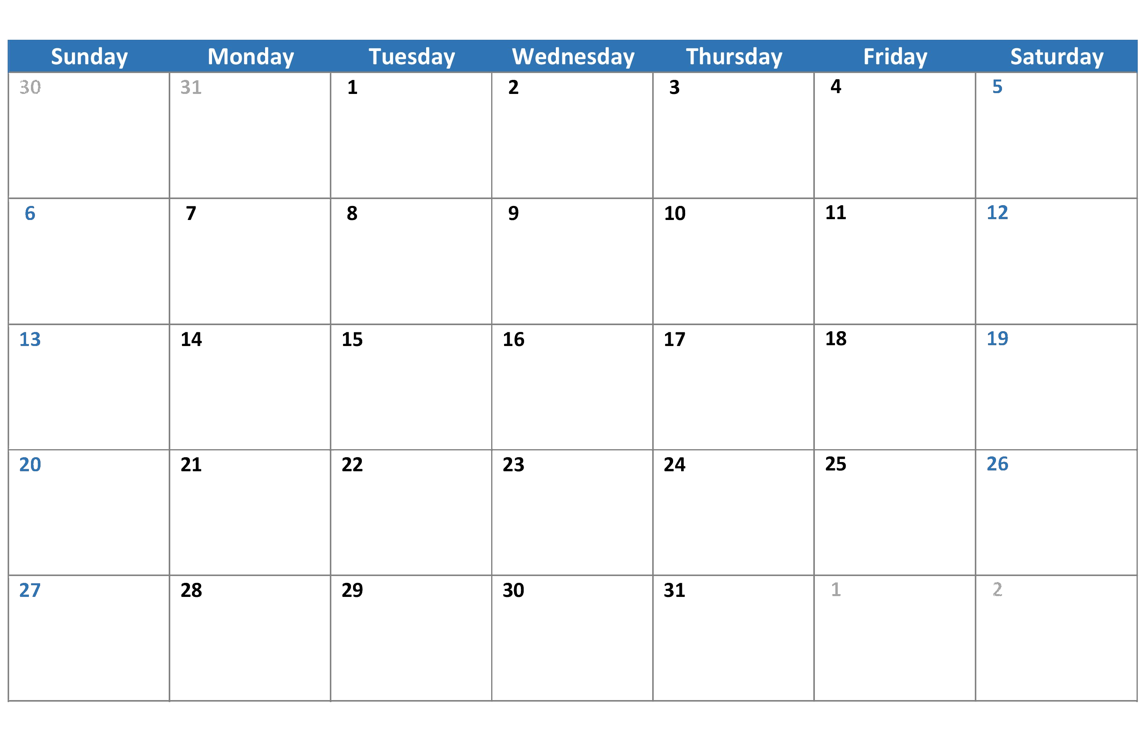

Medication – Select day
10:57 am
February 2019
Confirm

Slide 23
Medication – Select day
10:57 am
February 2019
Confirm

Slide 24
Medication – Select day
10:57 am
February 2019
Confirm

Slide 25

Add Medication
10:57 am
Enter Medication Name
Search
Results
Notes
Dose:
Add
Notes:
can search for drugs to add to list
To be used mostly by doctors

Slide 26
Add Medication
10:57 am
Enter Medication Name
Search
Results
Notes
Dose:
Add
Notes:
can search for drugs to add to list
To be used mostly by doctors

Slide 27
Add Medication
10:57 am
Formohelid
Search
Results
Notes
Dose:
Add
Notes:
can search for drugs to add to list
To be used mostly by doctors

Slide 28
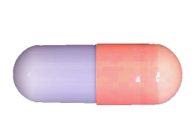
Add Medication
10:57 am
Formohelid
Search
Results:
Formohelidicas
Formohelidiel
Formohelidiate
Formohelidrine
Notes:
Formohelidrine:
Dose – 2x 50 mg tablets taken once in the morning before breakfast.
Tablets are oblong, red and purple capsules.
Do not take if pregnant or if you have fainted in the last three days.
Dose:
Add
Notes:
can search for drugs to add to list
To be used mostly by doctors

Slide 29
Medication
10:57 am
Tetracoloridine
x
2
Medication details
Do not take if pregnant or if you have fainted in the last three days.
To be taken at: 6:00pm
Dosage
2x 50 mg tablets taken once in the morning before breakfast.
Notes:
Detailed notes on medication

Slide 30
Medication
10:57 am
Formohelidrine
x
1
Medication details
Do not take if pregnant or if you have fainted in the last three days.
To be taken at: 8:00am
Dosage
1x 10 mg tablets taken once in the morning before breakfast.
Notes:
Detailed notes on medication

Slide 31
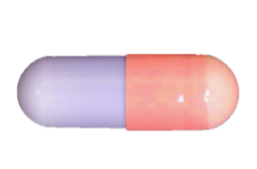
Medication
10:57 am
Oxytocin
x
1
Medication details
Do not take if pregnant or if you have fainted in the last three days.
To be taken at: 11:00am
Dosage
1x 50 mg tablets taken once in the morning before breakfast.
Notes:
Detailed notes on medication

Slide 32










Robot Assistant
10:57 am

Slide 33
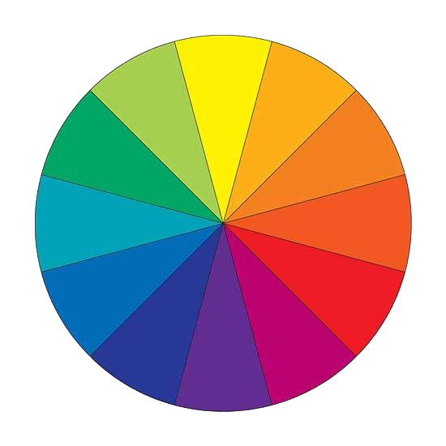






Settings
10:57 am
Change Colour Scheme
Select Colour
Reset
Notes:
Select which area user wants to change colour scheme and the select colour wanted.

Slide 34
Settings
10:57 am
Change Colour Scheme
Select Colour
Reset
Notes:
Select which area user wants to change colour scheme and the select colour wanted.

